Slide 1

http://newcastlesoftheworld.com/
www.facebook.com/nclsoftheworld

Slide 2



THE “NEWCASTLES” OF THE WORLD
There are over 100 towns and cities across the world that share the name “Newcastle” or “New Castle”
The origin of the name is often the same, whatever the language - an old castle was destroyed or fell into disrepair and a “new” castle was built to replace it, and the place name followed.
However, many of the Newcastles in the English-speaking world take their name from some connection with Newcastle upon Tyne and coal mining, and the idea to link them came from Newcastle upon Tyne-based John Nicolaou.
Some of the “Newcastles” have been meeting every two years to share experience and ideas on culture, heritage, education and business. This began in 1998 at the invitation of the then Mayor of Shinshiro, the “Newcastle” of Japan, and this is where “Newcastles of the World”, as we know it today, began.
Why not find out more?
http://newcastlesoftheworld.com/
www.facebook.com/nclsoftheworld

Slide 3
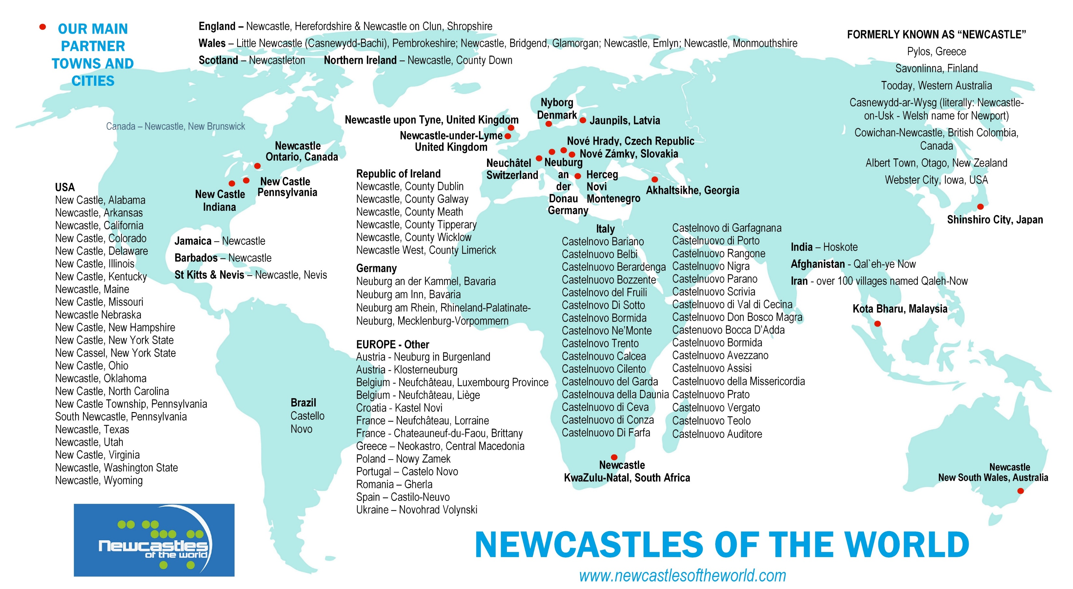

Slide 4

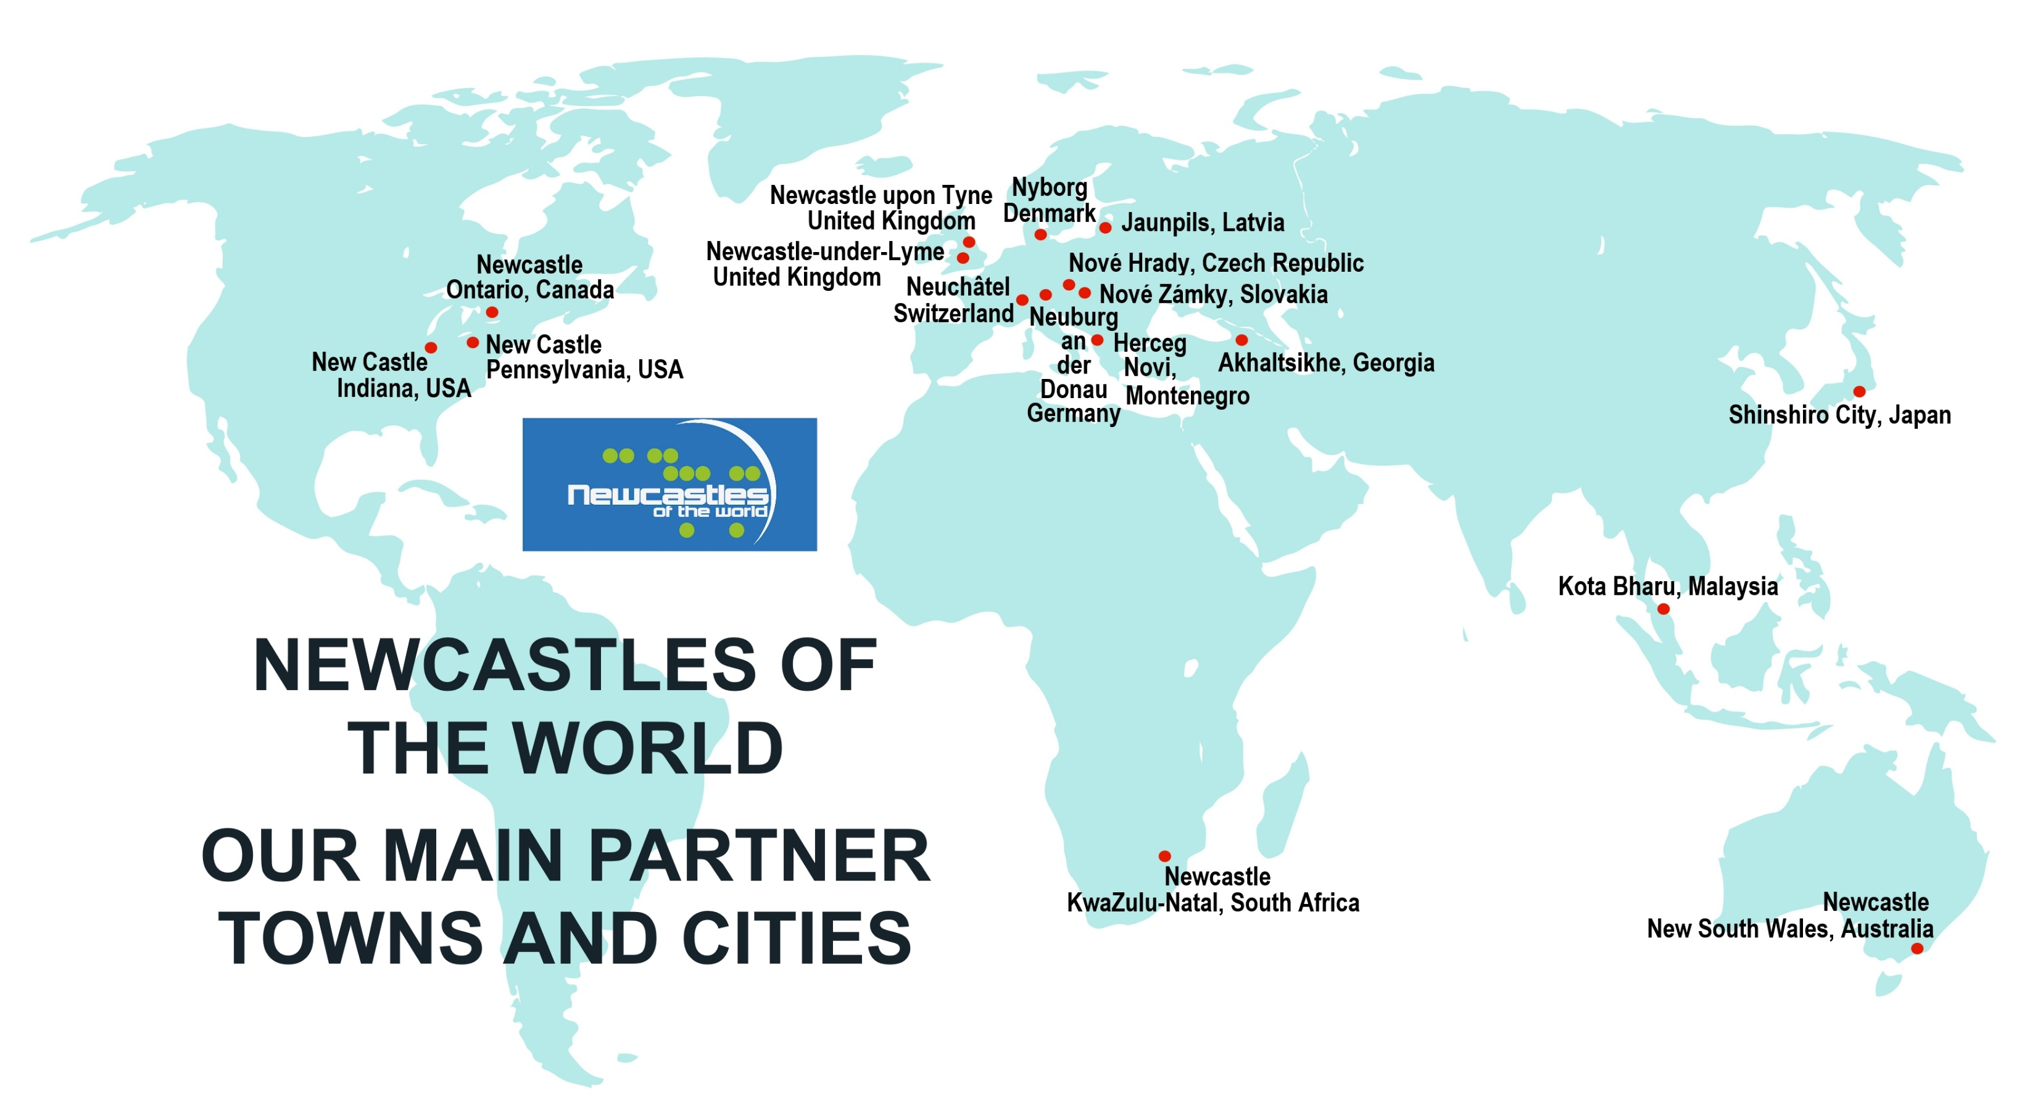

Slide 5
OUR MAIN PARTNER NEWCASTLES GROUPED BY SIZE
1,000 – 3,000 Nové Hrady (Czech Republic); Jaunpils (Latvia)
3,000 – 10,000 Newcastle Ontario (Canada), Neufchâteau (Belgium)
10,000 – 50,000 Neuchâtel,(Switzerland); Neuburg (Germany); Shinshiro (Japan); Herceg Novi (Montenegro); Akhaltsikhe (Georgia); Nyborg (Denmark); New Castle Indiana (USA); New Castle, Pennsylvania (USA); Nové Zámky (Slovakia)
50,000 – 100,000 Newcastle-under-Lyme (UK) (town 75,000, borough/council 124,000)
Over 100,000 Newcastle upon Tyne (United Kingdom – 300,000); Kota Bharu (Malaysia - 575,000); Newcastle New South Wales, (Australia – 170,000); Newcastle KwaZulu-Natal (South Africa - 400,000)

Slide 6
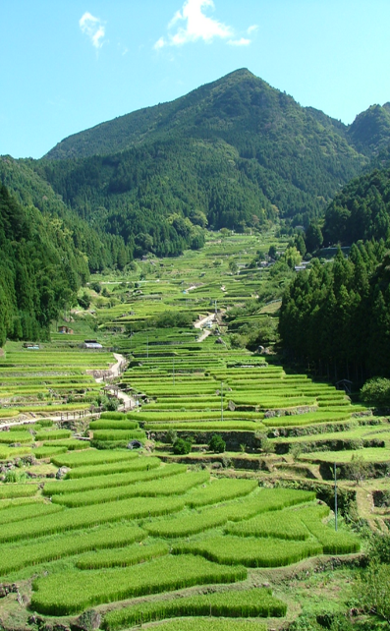
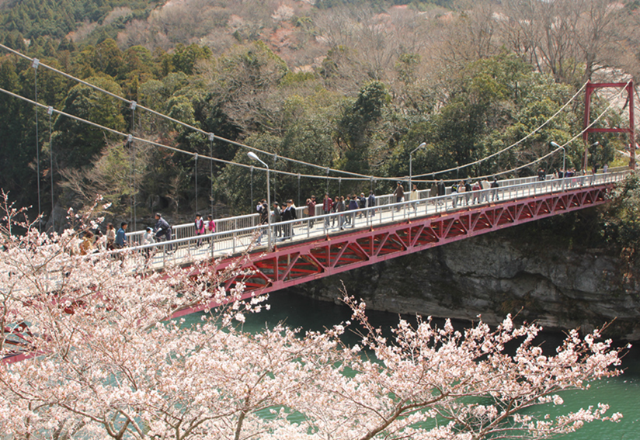
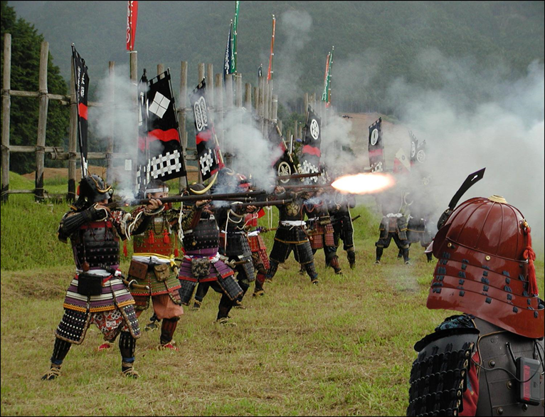

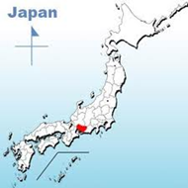
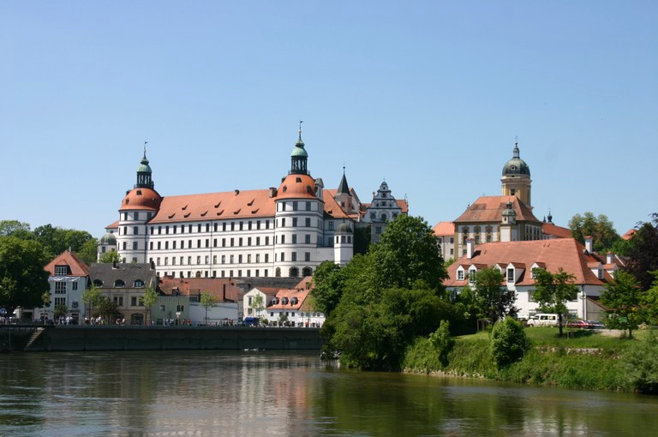
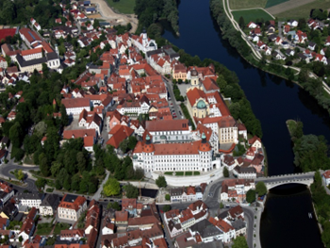
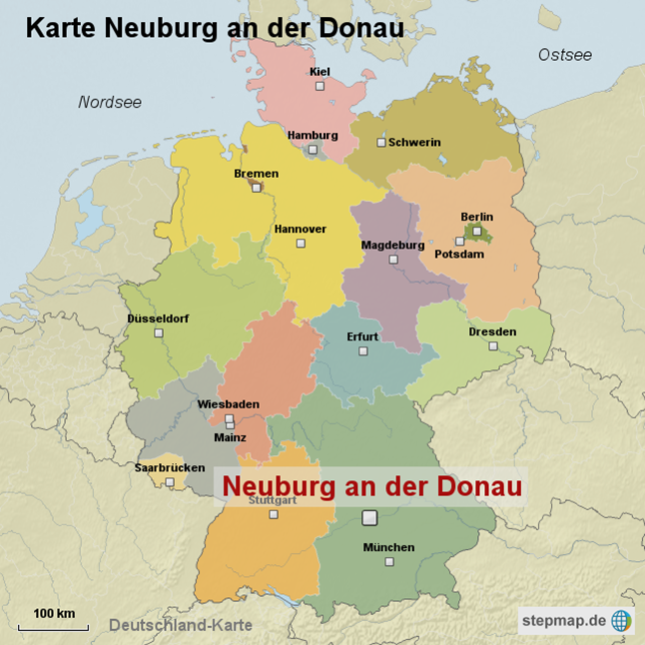

Shinshiro City, Japan, population 50,000, is 220km SW of Tokyo
Neuburg an der Donau (“Newcastle on the Danube”) is 80km north of Munich, Germany and has a population of 30,000

Slide 7
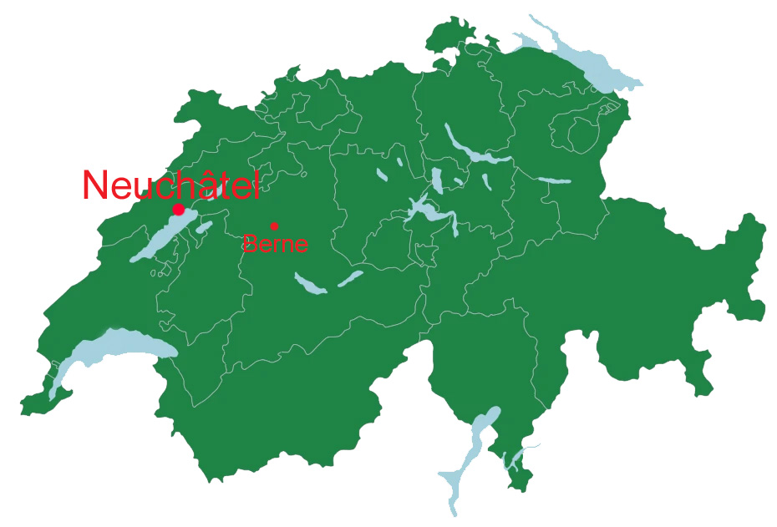

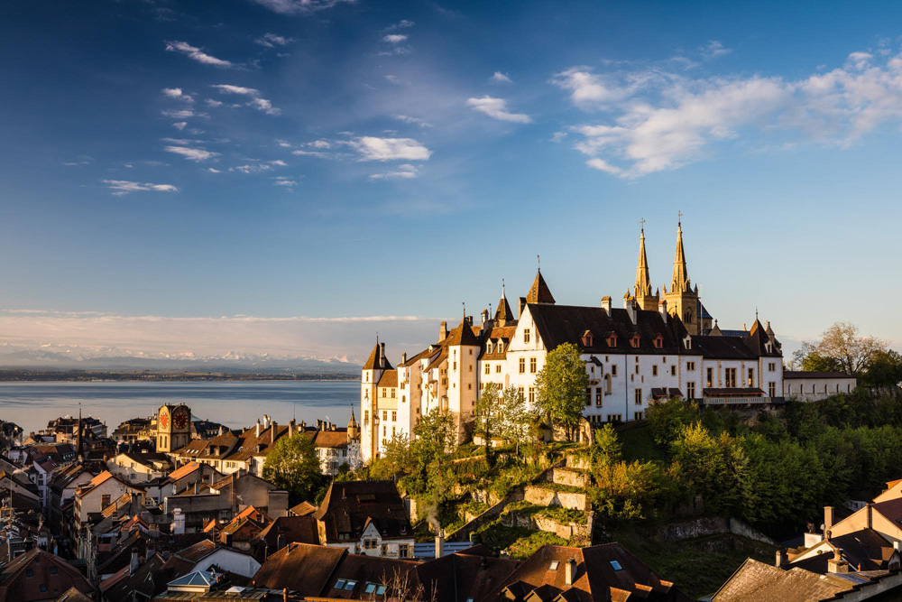


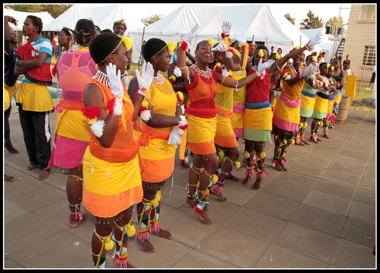
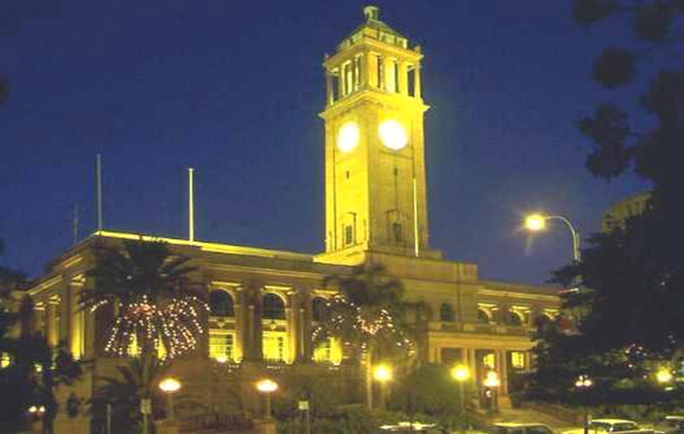
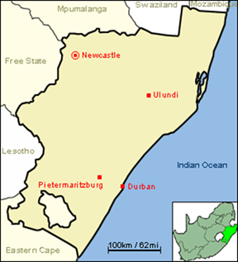

Neuchâtel is a 1000 year old city, in the French-speaking part of Switzerland, with a population of 45,000.
Newcastle KwaZulu Natal, South Africa has a population of around 400,000 including large townships; it is 260km NW of Durban.

Slide 8
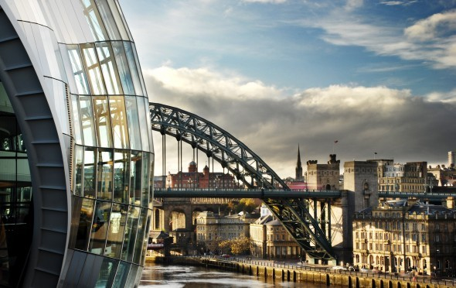

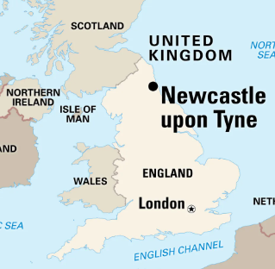
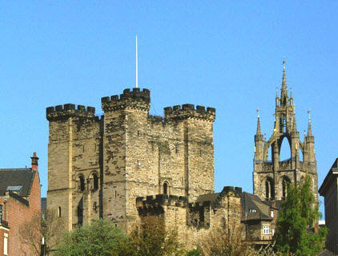
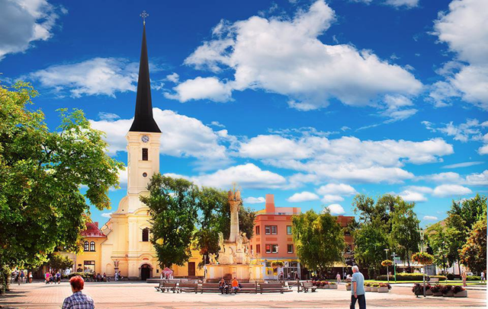

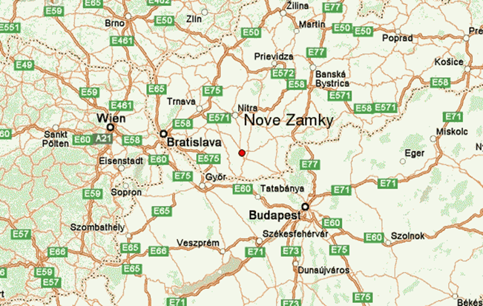

Newcastle upon Tyne is in North East England, population 300,000
Nové Zámky is in Slovakia, on the Nitra Rover, west of the capital Bratislava, with a population of 42,000

Slide 9
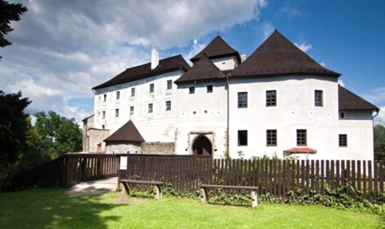
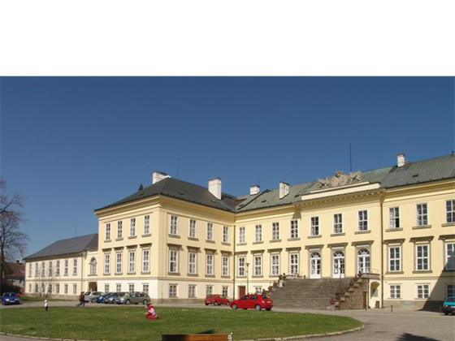

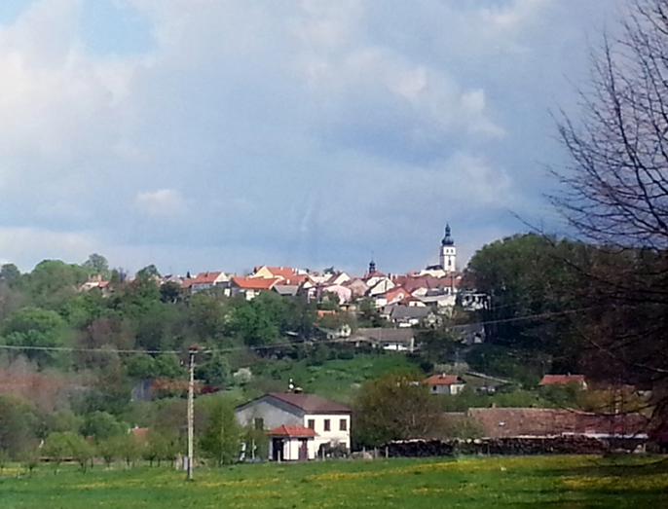
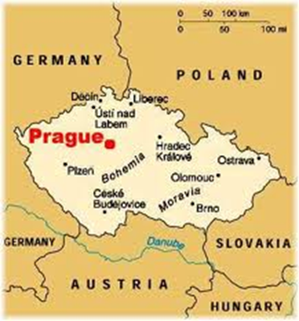
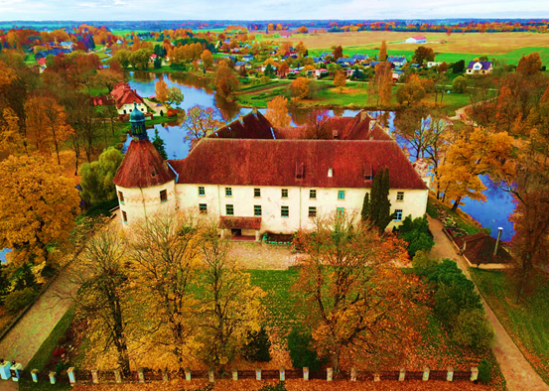
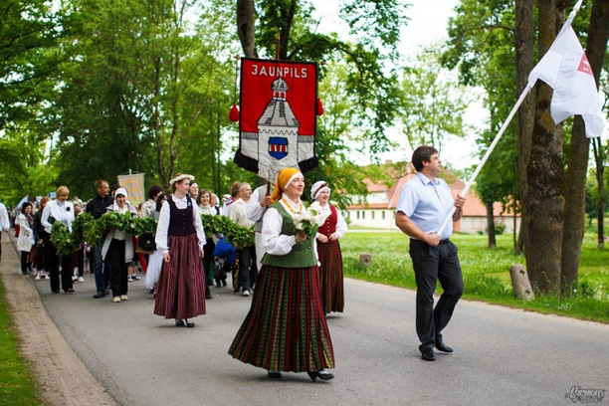
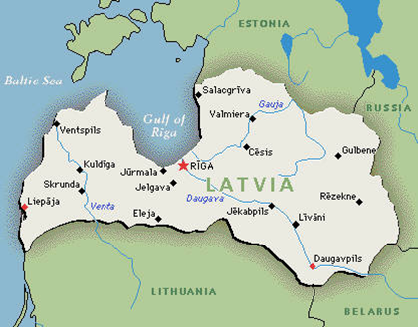

Nové Hrady, South Bohemia, Czech Republic, on the Austrian border. Population 2600
Jaunpils, Latvia - population of 2400 people; now part of Tukums municipality

Slide 10
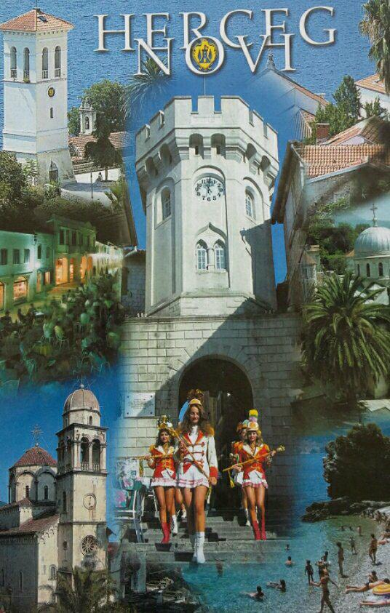
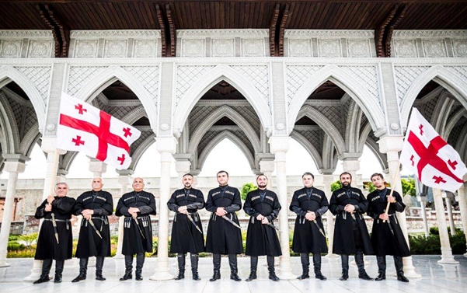

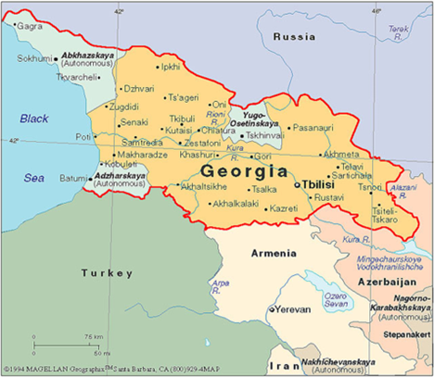

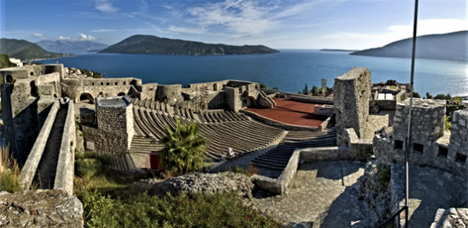
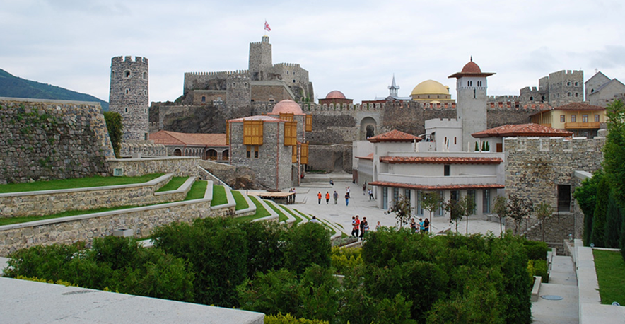
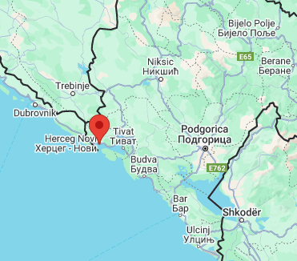
Herceg Novi, Montenegro - at the entrance to the Bay of Kotor. Municipality population 32,000; city = 16,000
Akhaltsikhe, Republic of Georgia
Population 17,000 (Municipality 46,000) South West Georgia, close to the border with Turkey and Armenia

Slide 11
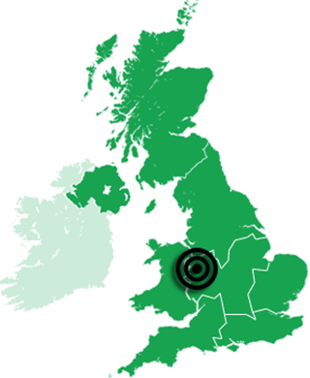
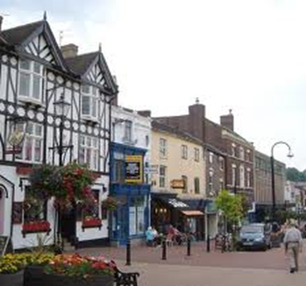
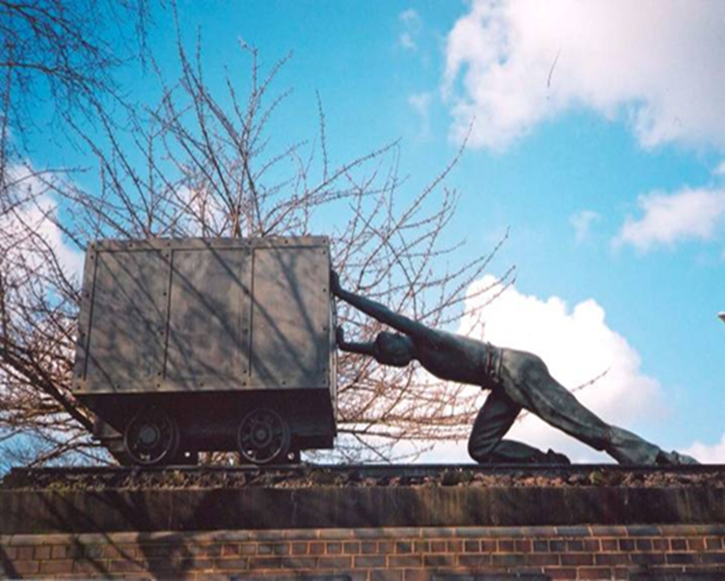


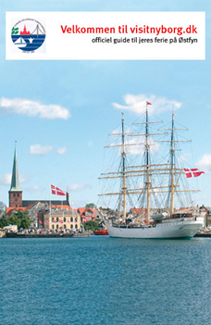

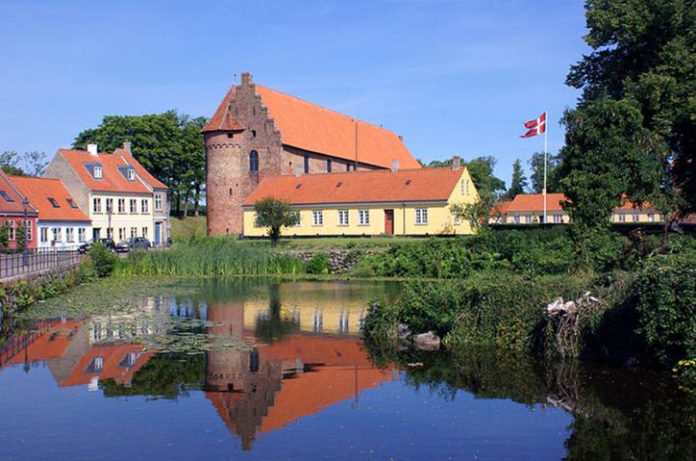
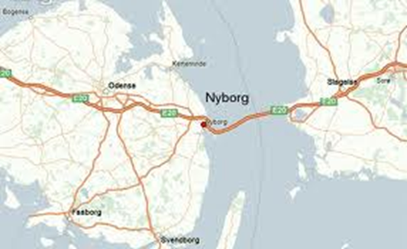
Newcastle-under-Lyme is a market town in Staffordshire, England, The borough has a population of 123,000 (of which the town is 75,000)

Slide 12
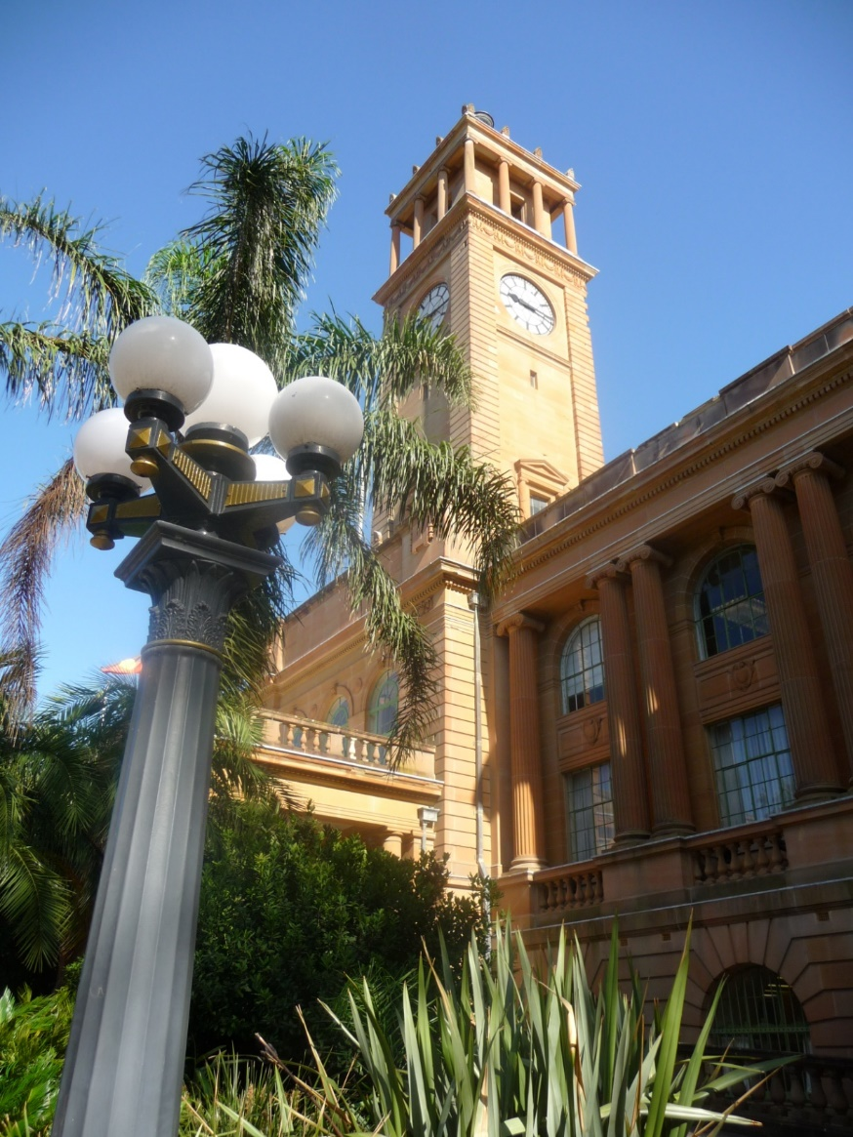
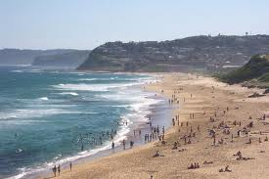
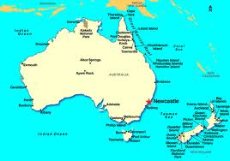

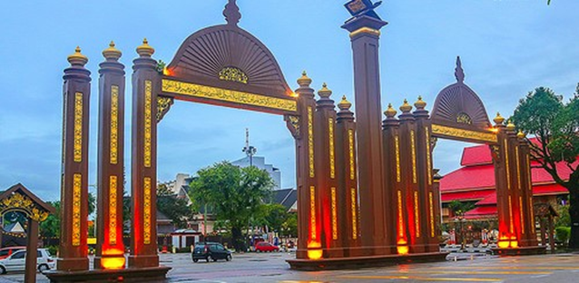

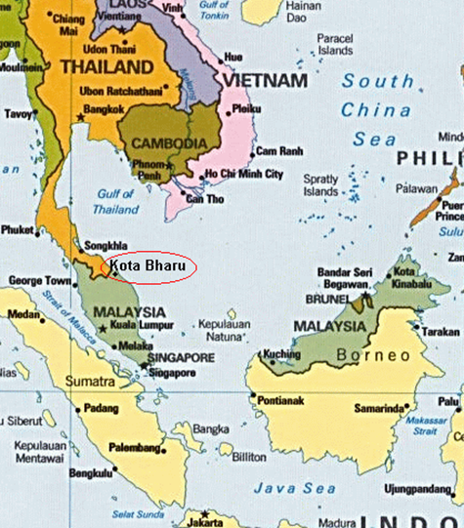
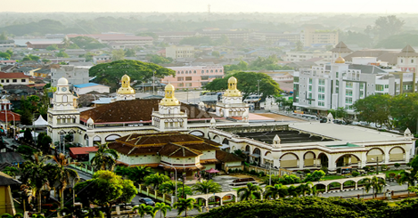
Newcastle
New South Wales
Australia
260km north of Sydney, Newcastle is Australia’s 7th largest city, population 170,000
Kota Bharu – state capital and Royal City of Kelantan State in northern Malaysia, near the border with Thailand – population 575,000.

Slide 13
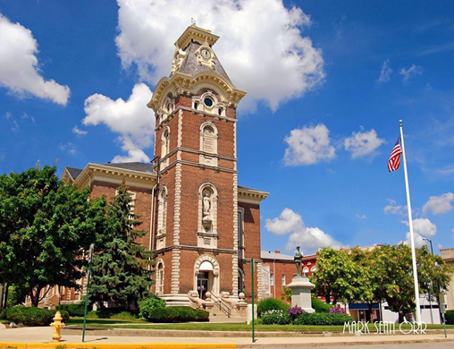
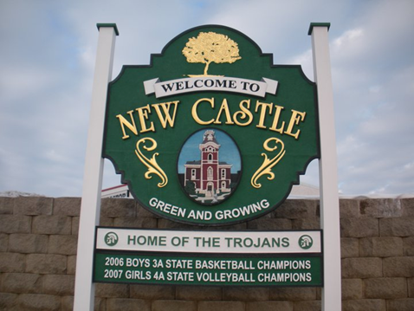
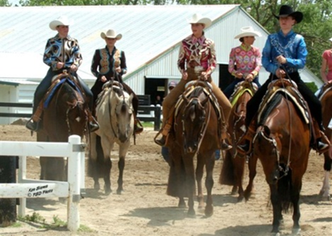


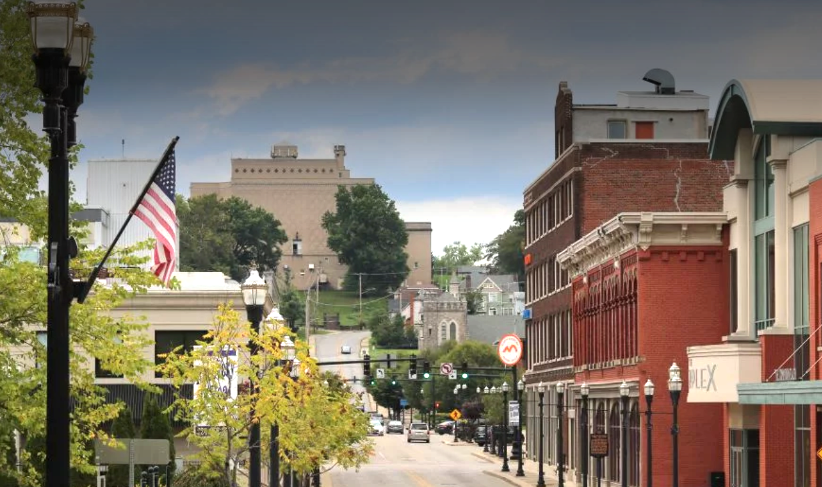
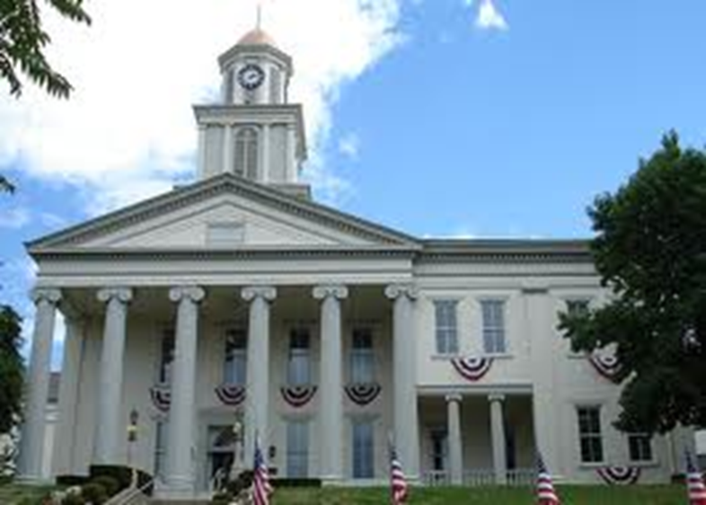
New Castle, Indiana, USA population 17,000
New Castle, Pennsylvania, USA, population 21,500

Slide 14
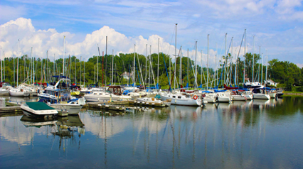








Neufchâteau, Belgium - 8,000 population

Slide 15
OPPORTUNITIES TO LINK UP
Trade, business development, chambers of commerce
Tourism promotion
Cultural collaborations and exchanges
Youth Councils and youth exchanges
University and college cooperation, schools, languages
Libraries
Charitable support for less well-developed communities
Sporting links
Rotary and Lions Clubs, Round Tables

Slide 16
OUR CONFERENCES
In 1998 the Mayor of Shinshiro in Japan took the initiative to invite representatives of seven other “Newcastles“ to his city.
They have continued to meet every two years – in Neuchâtel, Switzerland in 2000, USA (Indiana/Pennsylvania) in 2002, South Africa 2004 & 2010, Newcastle-under-Lyme (UK) in 2006, Neuburg an der Donau, Germany in 2008, Newcastle upon Tyne (UK) in 2012, Nové Hrady in the Czech Republic in 2014, Newcastle Ontario, Canada in 2016 and Shinshiro City Japan again for our 20th anniversary in 2018. We next met in 2023 in Nové Hrady for the conference that was postponed from 2020 because of Covid-19 and most recently in Jaunpils, Latvia in 2025
The aim of the Newcastles alliance is to foster friendship and collaboration, and to share and enjoy each other’s heritage and culture. Each gathering takes discussion themes to ensure practical, usable outcomes, and also involves our young people.
The next conference will be in Neuburg an der Donau, Bavaria, Germany in 2027

Slide 17




Our 2025 Conference in Jaunpils, Latvia

Slide 18

SOME OF OUR PROJECTS

Slide 19


Slide 20

Shinshiro City Passport
Shinshiro City, Japan gathered their offers and have a fantastic range including:
Guided Hiking at Mount Horaiji
Guided City tour
Free entrance for municipal museums
Zen experience at a temple including:
- Making Soba noodles
- Tea ceremony
- Wearing Samurai Costume
Meet the Mayor
Dine/stay with a host family
Picking up from nearest Bullet train station Toyohashi or nearest airport Chubu Nagoya

Slide 21





“Two Newcastles” Theatre Project

Slide 22


17 Artists from 14 “Newcastles” were part of Nové Zámky’s special year as Slovakia’s City of Culture in a special project

Slide 23


Slide 24



Some of our Publications

Slide 25
SHARING INFORMATION AND BEST PRACTICE IN AREAS OF COMMON INTEREST http://newcastlesoftheworld.com/best-practice-information/
Ensuring thriving town and district centres
New uses for historic buildings
An ageing population- issues and opportunities
Environmental sustainability
The “Smart” City
Maximising our tourism potential through collaboration

Slide 26








Young people are the Future for our Newcastles

Slide 27

IN 2017, WE HELD A DEDICATED YOUTH CONFERENCE IN SHINSHIRO, JAPAN

Slide 28


Slide 29




Slide 30



Slide 31


CHRIS BROWNHILL OF NORTHUMBRIA UNIVERSITY – NINE MONTH PLACEMENT WITH A JAPANESE COMPANY IN SHINSHIRO (OSG)

Slide 32
WHAT YOU’LL FIND ON THE WEBSITE
About the Newcastles around the world
Newsletters and features
Opportunities and projects
Sharing best practice
Our calendar of major events in the different Newcastles
More about youth and seniors
Business and Tourism
Your contacts in our Newcastles
http://newcastlesoftheworld.com/
www.facebook.com/nclsoftheworld
Mo

Slide 33






OUR QUARTERLY NEWSLETTER

